Slide 1





© 2019 Tryolabs
An Introduction to Machine
Learning and How to Teach
Machines to See
Facundo Parodi Tryolabs May 2019

Slide 2


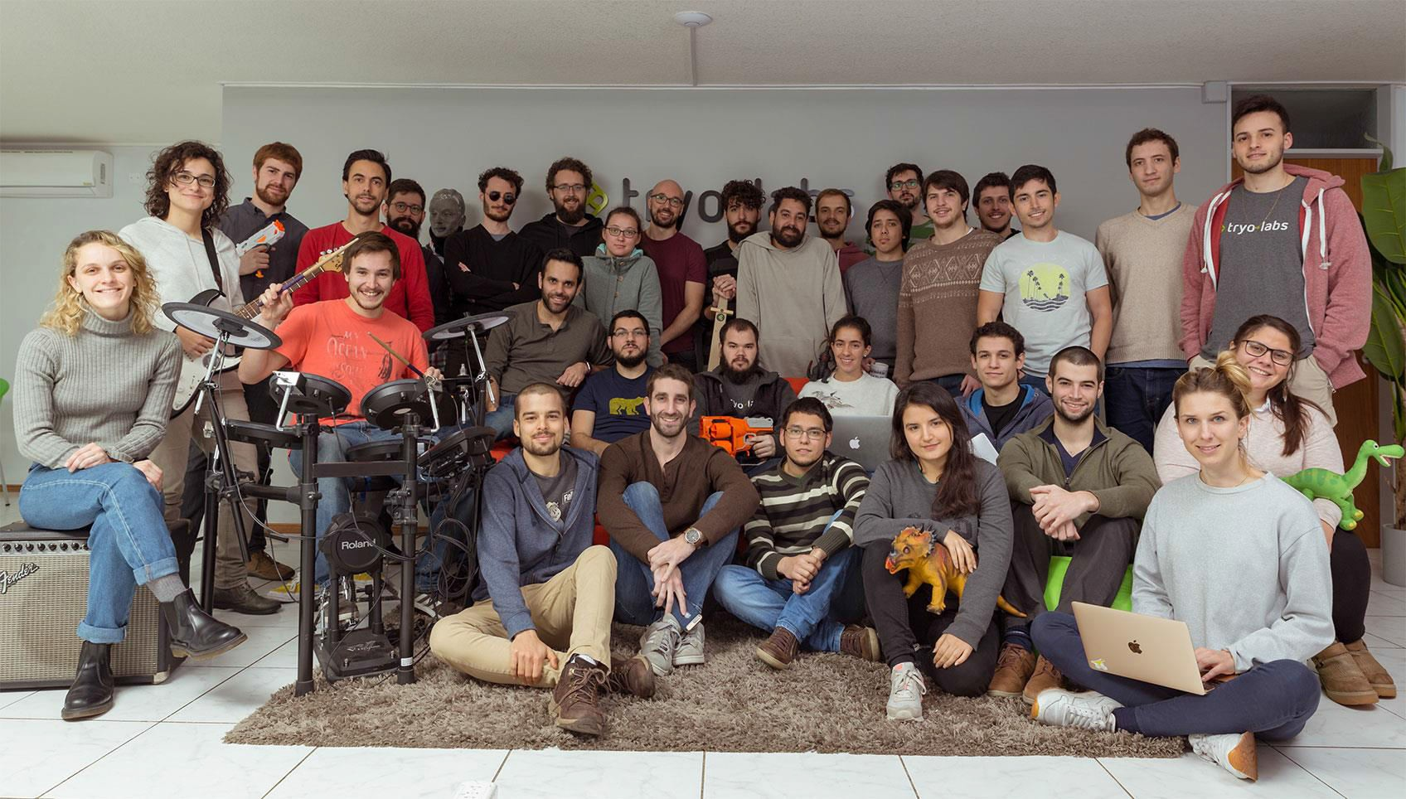
Who are we?

Slide 3
Outline
Machine Learning
Types of Machine Learning Problems
Steps to solve a Machine Learning Problem Deep Learning
Artificial Neural Networks
Image Classification
Convolutional Neural Networks

Slide 4

© 2019 Tryolabs
What is a Cat?

Slide 5


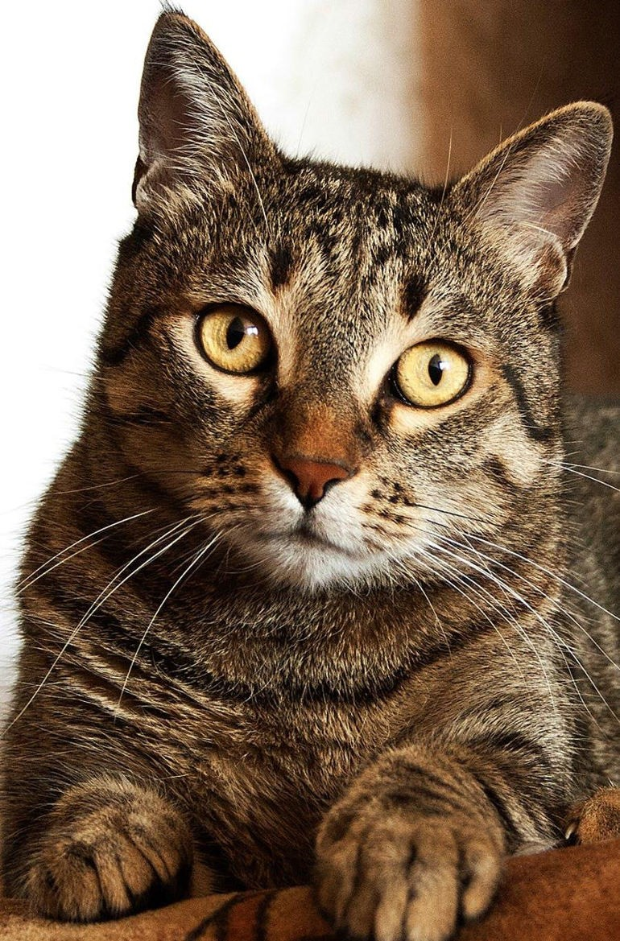
What is a Cat?

Slide 6




What is a Cat?
Occlusion
Diversity
Deformation
Lighting variations

Slide 7

© 2019 Tryolabs
Introduction to
Machine Learning

Slide 8

What is Machine Learning?
Introduction to Machine Learning
The subfield of computer science that “gives computers the ability to learn
without being explicitly programmed”.
(Arthur Samuel, 1959)
A computer program is said to learn from experience E with respect to some class of tasks T and performance measure P if its performance at tasks in T, as measured by P, improves with experience E.”
(Tom Mitchell, 1997)
Using data for answering questions
Training Predicting

Slide 9
The Big Data Era
Introduction to Machine Learning
Data
Data already available everywhere
Low storage costs: everyone has several GBs for “free”
Hardware more powerful and cheaper than ever before
Devices
Services
Cloud Computing:
Online storage
Infrastructure as a Service
User applications:
Everyone has a computer fully packed with sensors:
GPS
Cameras
Microphones
YouTube
Gmail
Facebook
Twitter
Permanently connected to Internet

Slide 10
Types of Machine Learning Problems
Introduction to Machine Learning
Supervised
Unsupervised
Reinforcement
10

Slide 11
Types of Machine Learning Problems
Introduction to Machine Learning
Learn through examples of which we know the desired output (what we want to predict).
Supervised
Is this a cat or a dog?
Are these emails spam or not?
Unsupervised
Predict the market value of houses, given the square meters, number of rooms, neighborhood, etc.
Reinforcement

Slide 12
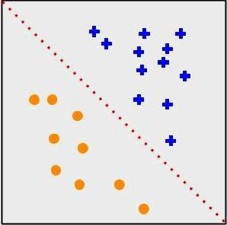
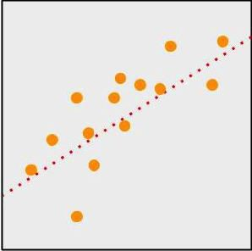
Types of Machine Learning Problems
Introduction to Machine Learning
Supervised
Classification
Output is a discrete variable (e.g., cat/dog)
Unsupervised
Regression
Output is continuous
(e.g., price, temperature)
Reinforcement

Slide 13
Types of Machine Learning Problems
Introduction to Machine Learning
Supervised
There is no desired output. Learn something about
the data. Latent relationships.
Unsupervised
I have photos and want to put them in 20 groups.
I want to find anomalies in the credit card usage patterns of my customers.
Reinforcement

Slide 14
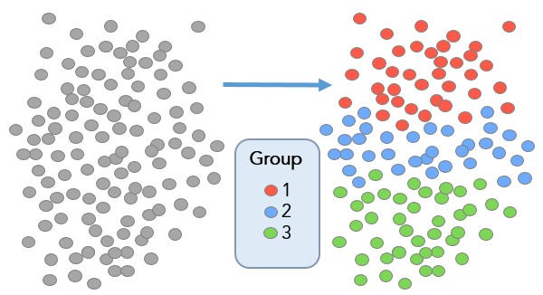
Types of Machine Learning Problems
Introduction to Machine Learning
Supervised
Useful for learning structure in the data (clustering), hidden correlations, reduce dimensionality, etc.
Unsupervised
Reinforcement

Slide 15
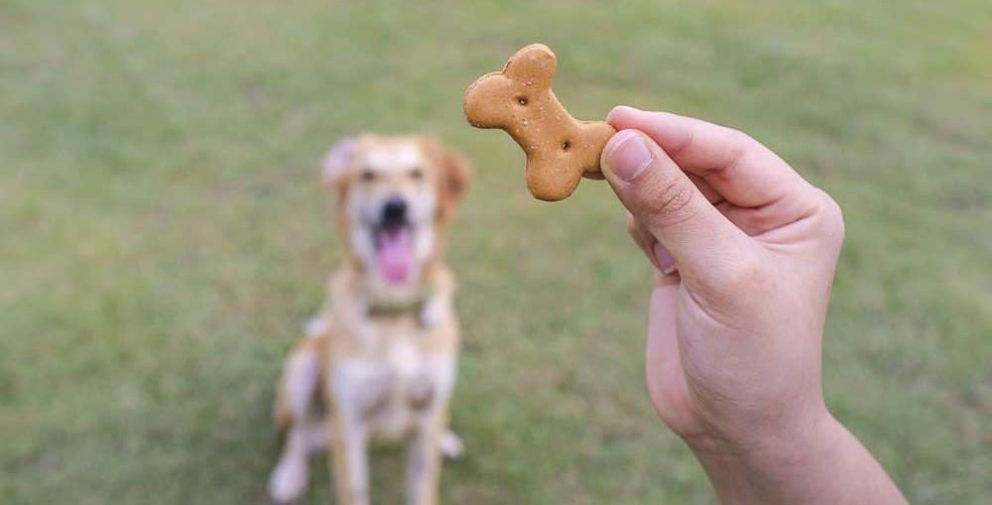
Types of Machine Learning Problems
Introduction to Machine Learning
Supervised
An agent interacts with an environment and watches the result of the interaction.
Environment gives feedback via a positive or negative reward signal.
Unsupervised
Reinforcement

Slide 16
Introduction to Machine Learning
Steps to Solve a Machine Learning Problem
Data Gathering
Collect data from various sources
Data Preprocessing
Clean data to have
homogeneity
Feature Engineering
Making your data more useful
Algorithm Selection
& Training
Selecting the right machine learning model
Making Predictions
Evaluate the model

Slide 17
Data Gathering
Introduction to Machine Learning
Might depend on human work
Manual labeling for supervised learning.
Domain knowledge. Maybe even experts.
May come for free, or “sort of”
E.g., Machine Translation.
The more the better: Some algorithms need large amounts of data to be
useful (e.g., neural networks).
The quantity and quality of data dictate the model accuracy

Slide 18
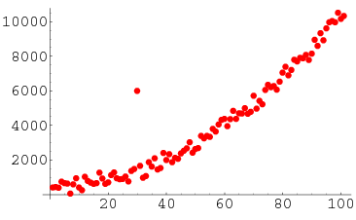
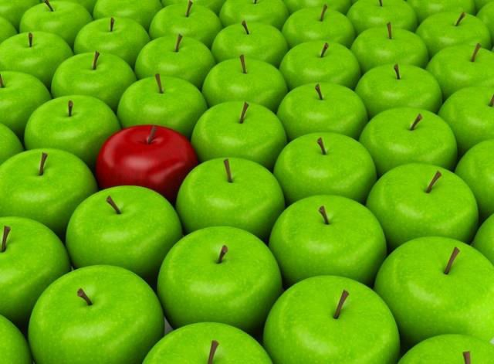
Data Preprocessing
Introduction to Machine Learning
Is there anything wrong with the data?
Missing values
Outliers
Bad encoding (for text)
Wrongly-labeled examples
Biased data
Do I have many more samples of one class than the rest?
Need to fix/remove data?

Slide 19
Feature Engineering
Introduction to Machine Learning
What is a feature?
A feature is an individual measurable property of a phenomenon being observed
Our inputs are represented by a set of features.
To classify spam email, features could be:
Number of words that have been ch4ng3d
like this.
Language of the email (0=English, 1=Spanish)
Number of emojis
Buy ch34p drugs from the ph4rm4cy now :) :) :)
Feature
engineering
(2, 0, 3)

Slide 20
Feature Engineering
Introduction to Machine Learning
Extract more information from existing data, not adding “new” data per-se
Making it more useful
With good features, most algorithms can learn faster It can be an art
Requires thought and knowledge of the data
Two steps:
Variable transformation (e.g., dates into weekdays, normalizing)
Feature creation (e.g., n-grams for texts, if word is capitalized to detect names, etc.)
20

Slide 21
Algorithm Selection & Training
Introduction to Machine Learning
Supervised
Unsupervised
Linear classifier
Naive Bayes
Support Vector Machines (SVM)
Decision Tree
Random Forests
k-Nearest Neighbors
Neural Networks (Deep learning)
PCA
t-SNE
k-means
DBSCAN
Reinforcement
SARSA–λ
Q-Learning

Slide 22




Algorithm Selection & Training
Introduction to Machine Learning
Goal of training: making the correct prediction as often as possible
Incremental improvement:
Predict
Adjust
Use of metrics for evaluating performance and comparing solutions
Hyperparameter tuning: more an art than a science

Slide 23















Making Predictions
Introduction to Machine Learning
Training Phase
Labels
Machine Learning
Samples
extraction
Features
Prediction Phase
Input
Feature extraction
Features
Trained classifier
Label

Slide 24
Summary
Introduction to Machine Learning
Machine Learning is intelligent use of data to answer questions
Enabled by an exponential increase in computing power and data availability
Three big types of problems: supervised, unsupervised, reinforcement
5 steps to every machine learning solution:
Data Gathering
Data Preprocessing
Feature Engineering
Algorithm Selection & Training
Making Predictions

Slide 25
© 2019 Tryolabs
Deep Learning
“Any sufficiently advanced technology is indistinguishable from magic.” (Arthur C. Clarke)

Slide 26
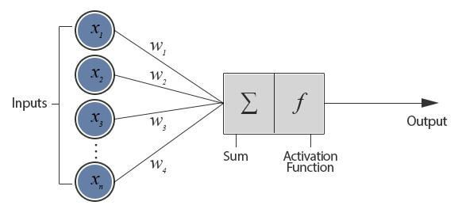
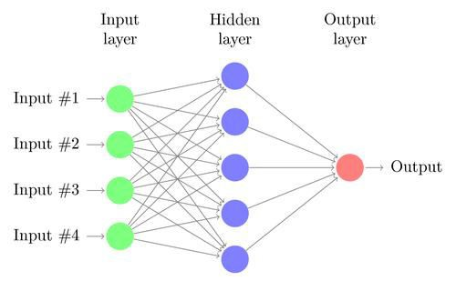
Artificial Neural Networks
Deep Learning
First model of artificial neural networks proposed in 1943
Analogy to the human brain greatly exaggerated
Given some inputs (𝑥), the network calculates some outputs (𝑦),
using a set of weights (𝑤)
Perceptron (Rosenblatt, 1957)
Two-layer Fully Connected Neural Network

Slide 27

Loss function
Deep Learning
Weights must be adjusted (learned from the data)
Idea: define a function that tells us how “close” the network is to
generating the desired output
Minimize the loss ➔ optimization problem
With a continuous and differentiable loss
function, we can apply gradient descent

Slide 28
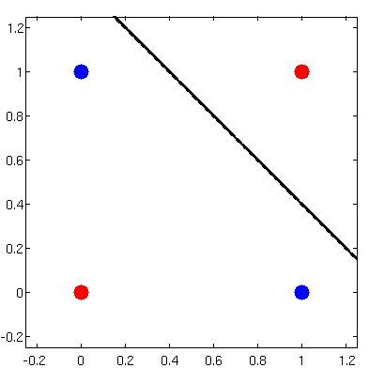
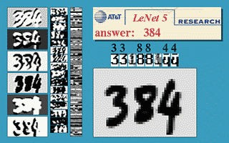
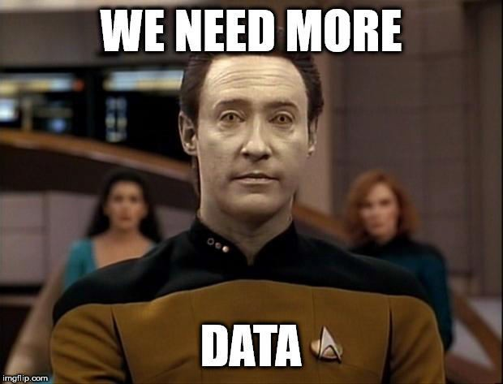
The Rise, Fall, Rise, Fall and Rise of Neural Networks
Deep Learning
Perceptron gained popularity in the 60s
Belief that would lead to true AI
XOR problem and AI Winter (1969 – 1986)
Backpropagation to the rescue! (1986)
Training of multilayer neural nets
LeNet-5 (Yann LeCun et al., 1998)
Unable to scale. Lack of good data and
processing power

Slide 29
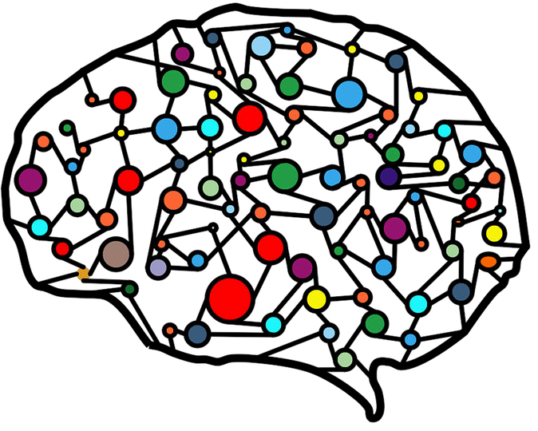
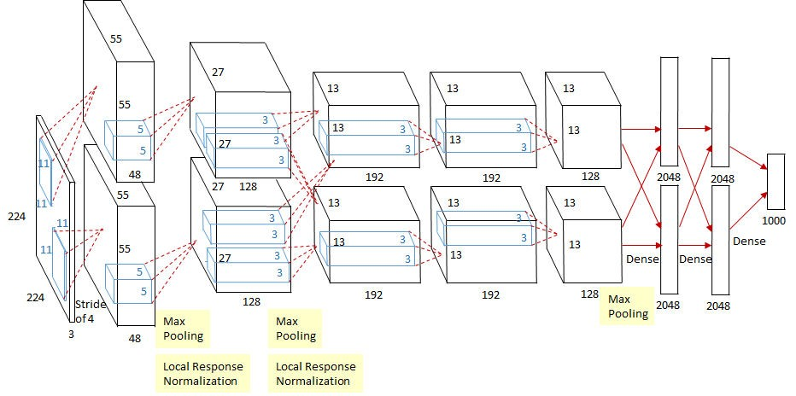
The Rise, Fall, Rise, Fall and Rise of Neural Networks
Deep Learning
Regained popularity since ~2006.
Train each layer at a time
Rebranded field as Deep Learning
Old ideas rediscovered (e.g., Convolution)
Breakthrough in 2012 with AlexNet (Krizhevsky et al.)
Use of GPUs
Convolution

Slide 30
© 2019 Tryolabs
Image Classification with
Deep Neural Networks

Slide 31

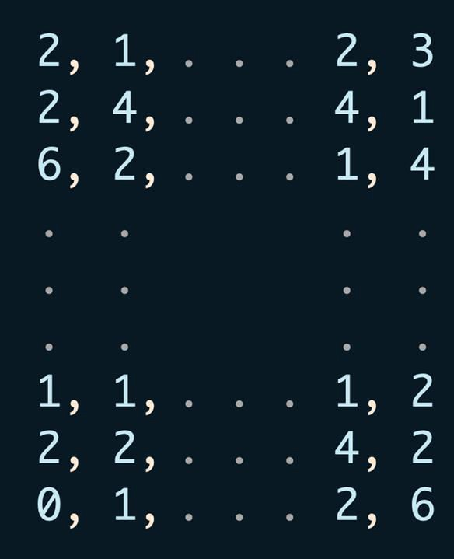
Digital Representation of Images
Image Classification with Deep Neural Networks
=
31

Slide 32
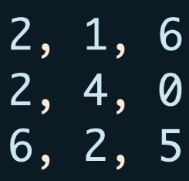
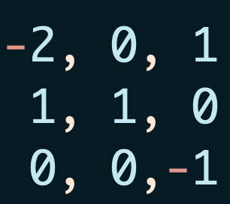
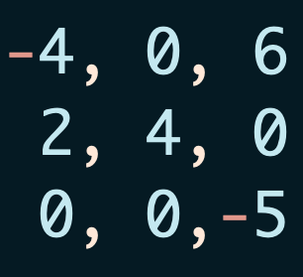

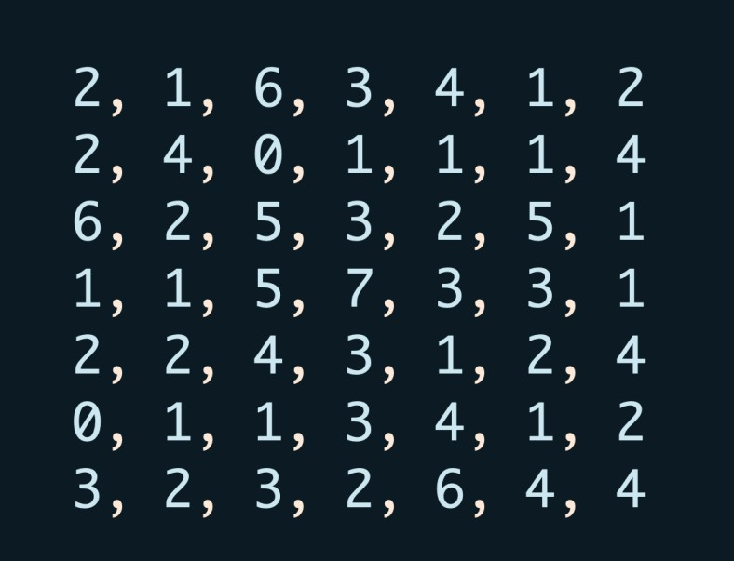

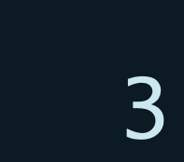
The Convolution Operator
Image Classification with Deep Neural Networks
∑
⊙
=
Kernel
Input
Output

Slide 33
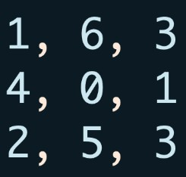
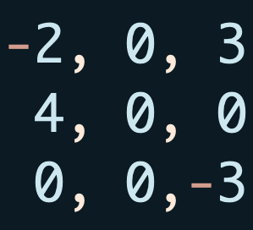

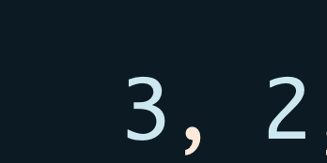
The Convolution Operator
Image Classification with Deep Neural Networks
∑
⊙
=
Kernel
Input
Output

Slide 34
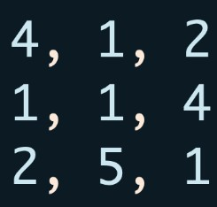
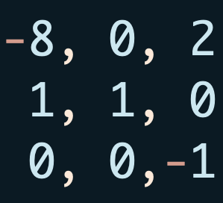

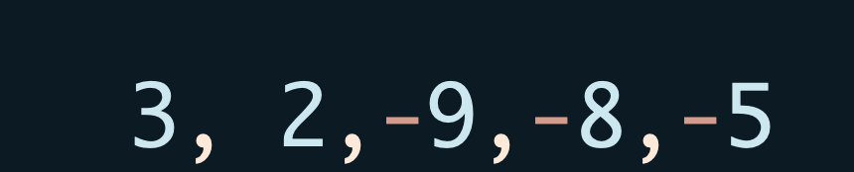
The Convolution Operator
Image Classification with Deep Neural Networks
∑
⊙
=
Kernel
Input
Output

Slide 35
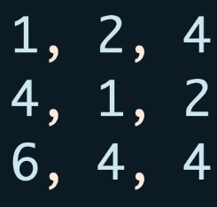
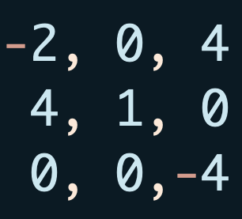

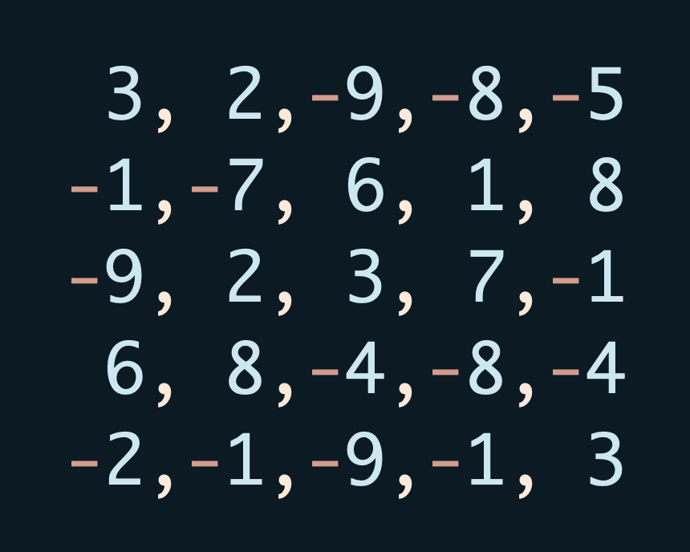
The Convolution Operator
Image Classification with Deep Neural Networks
∑
⊙
=
Kernel
Input
Output

Slide 36
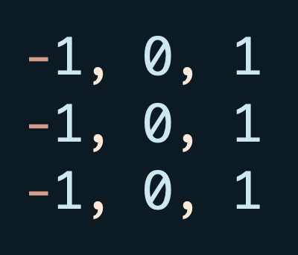
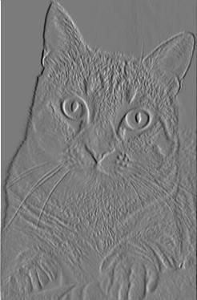

The Convolution Operation
Image Classification with Deep Neural Networks
Kernel
Input
Feature Map

Slide 37


Image Classification with Deep Neural Networks
The Convolution Operation

Slide 38



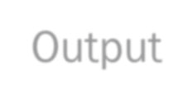



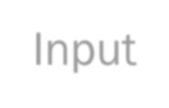
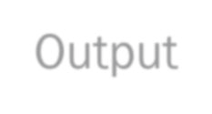

The Convolution Operation
Image Classification with Deep Neural Networks
Takes spatial dependencies into account
Used as a feature extraction tool
Differentiable operation ➔ the kernels can be learned
Traditional ML
Input
Feature extraction
Features
Trained classifier
Output
Deep Learning
Input
Trained
classifier
Output

Slide 39
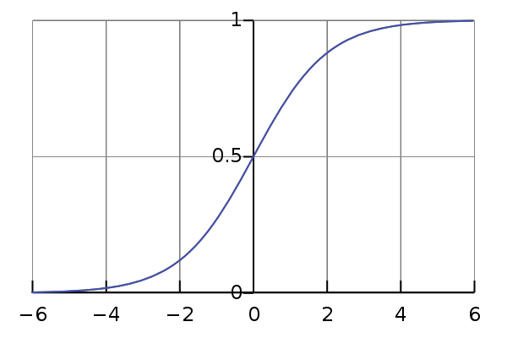
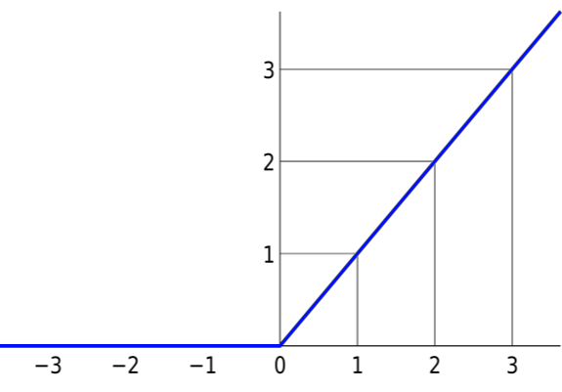
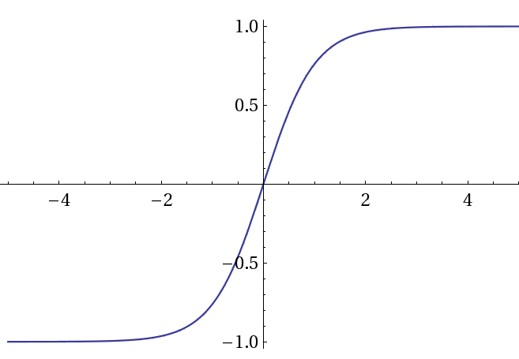
Non-linear Activation Functions
Image Classification with Deep Neural Networks
Increment the network’s capacity
Convolution, matrix multiplication and summation are linear
Sigmoid
1
𝑓 𝑥 =
1 + 𝑒^{−𝑥}
Hyperbolic tangent
_{𝑒}2𝑥−1
𝑡𝑎𝑛ℎ 𝑥 =
_{𝑒}2𝑥+1
ReLU
𝑓 𝑥 = max(0, 𝑥)

Slide 40

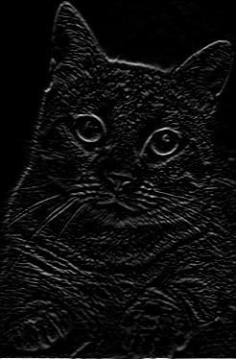
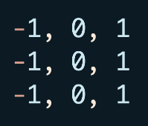
Non-linear Activation Functions
Image Classification with Deep Neural Networks
ReLU
40

Slide 41
The Pooling Operation
Image Classification with Deep Neural Networks
12 | 20 | 30 | 0
8 | 12 | 2 | 0
34 | 70 | 37 | 4
112 | 100 | 25 | 12
20 | 30
112 | 37
2x2 Max Pooling
Used to reduce dimensionality
Most common: Max pooling
Makes the network invariant to small transformations,
distortions and translations.

Slide 42

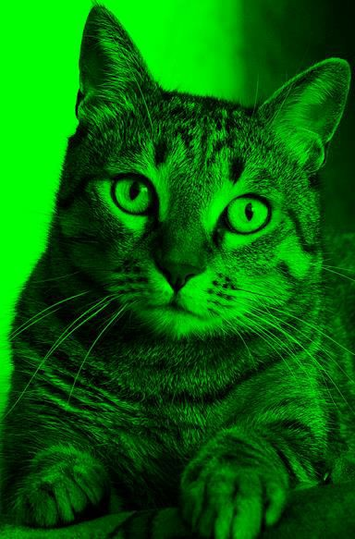




Image Classification with Deep Neural Networks
Putting all together
Input
Conv Layer
Non-Linear Function
Fully Connected Layers
Pooling
Conv Layer
Non-Linear Function
…
Pooling
Conv Layer
Non-Linear Function
Flatten
Feature extraction
Classification

Slide 43


Training Convolutional Neural Networks
Image Classification with Deep Neural Networks
Image classification is a supervised problem
Gather images and label them with desired output
Train the network with backpropagation!
Convolutional Network
Prediction: Dog
Loss
Function
Label: Cat

Slide 44

Training Convolutional Neural Networks
Image Classification with Deep Neural Networks
Image classification is a supervised problem
Gather images and label them with desired output
Train the network with backpropagation!
Convolutional Network
Prediction: Cat
Loss
Function
Label: Cat

Slide 45
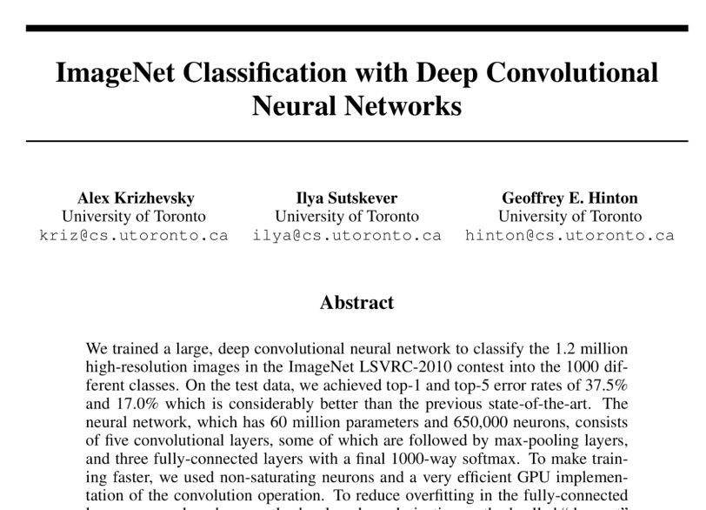
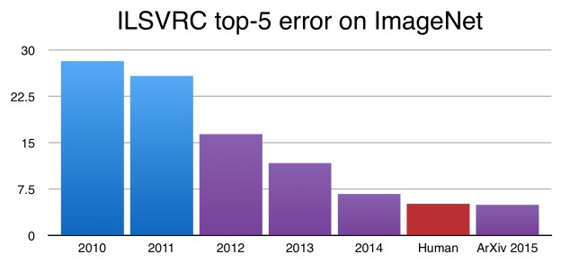
Image Classification with Deep Neural Networks
Surpassing Human Performance

Slide 46

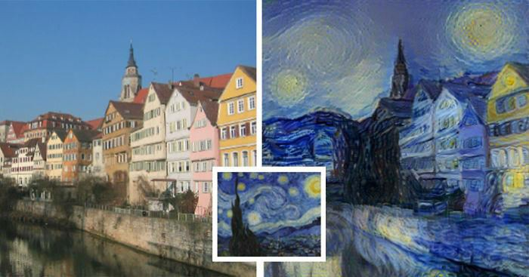

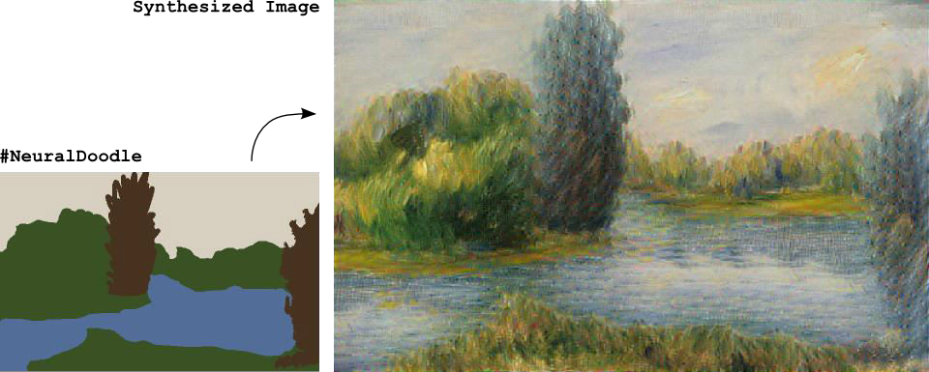
Deep Learning in the Wild

Slide 47

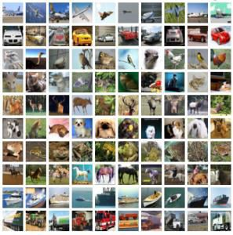
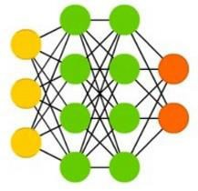







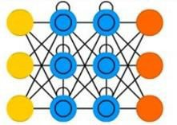


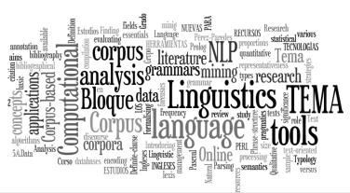




Deep Learning is Here to Stay
Data
Architectures
Frameworks
Power
Players

Slide 48
Conclusions
Machine learning algorithms learn from data to find hidden relations, to
make predictions, to interact with the world, …
A machine learning algorithm is as good as its input data
Good model + Bad data = Bad Results
Deep learning is making significant breakthroughs in: speech recognition,
language processing, computer vision, control systems, …
If you are not using or considering using Deep Learning to understand or
solve vision problems, you almost certainly should be

Slide 49
Resource
Our work
Tryolabs Blog https://www.tryolabs.com/blog
Luminoth (Computer Vision Toolkit) https://www.luminoth.ai
To Learn More…
Google Machine Learning Crash Course https://developers.google.com/machine- learning/crash-course/
Stanford course CS229: Machine Learning https://developers.google.com/machine- learning/crash-course/
Stanford course CS231n: Convolutional Neural Networks for Visual Recognition http://cs231n.stanford.edu/

Slide 50
© 2019 Tryolabs
Thank you!

